Slide 1
Instructions for Presentation
Each slide will have its own audio clip of me explaining the slide’s contents
The audio will not engage automatically
To engage the audio, click on the small speaker phone that will be present in the top left corner of every slide (or click the spacebar once after reaching a new slide)
When finished listening to the audio and examining the slide, proceed to the next slide

Slide 2

Analysis of Specimen Orientation Methodology for Energy Dispersive X-Ray Spectroscopy
Writer: Alexander T. Huey
Advisor: Dr. Chunfei Li
Second Reader: Dr. Min Li
HAB Member: Dr. Gregg Gould

Slide 3
Abstract:
When using a scanning electron microscope (S.E.M.) equipped with a spectrometer, it is difficult to know if the specimen being observed is in the optimal position to get the best readings from the equipment. Previous data collected by my advisor, the Principal Investigator (PI), and Clarion University (CU) has determined a method of specimen orientation through rotation and tilt of the specimen table to determine its optimal positioning. This was done by constructing a macroscale copy of the equipment found inside a S.E.M. and using it to measure the ratio of the specimen’s projected lengths versus the rotation of the specimen table. To confirm the methodology and interpretations of data developed in previous experiments, new data has been collected to test against previous trials. The newest trial has found evidence in support of previous findings, with similar data being produced. This is an indication that the developed method of orienting a specimen inside a S.E.M. may fill a gap in research dedicated to the use of lab equipment. Suggestions for further research and apparatus redesign will be offered along with the conclusions.

Slide 4
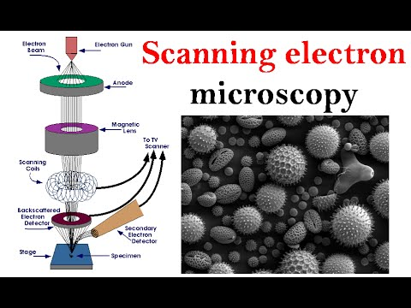
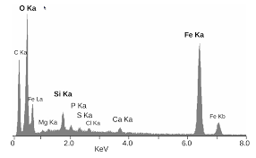
What is a SEM?
What is EDS?
SEM’s give a detailed picture of the topography of a specimen on the order of a few micrometers
EDS gives a detailed analysis of the composition of a specimen
Spectrometers can be added to a SEM to allow concurrent analysis of a specimen

Slide 5
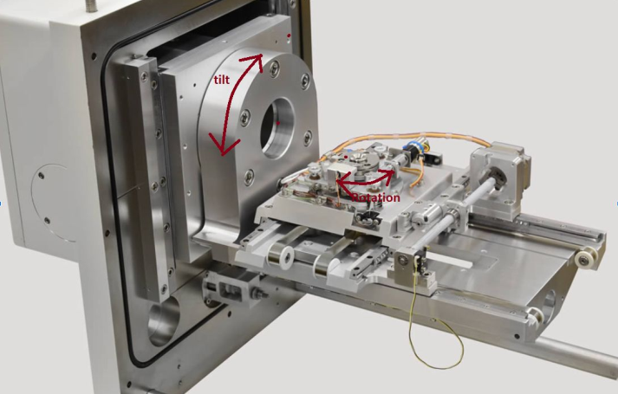
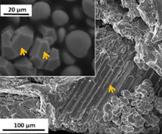
Why is this research important?
Not many people have done or are currently doing research in this area
Spectroscopy is non-destructive
Requires very little material
Results can form proposals to agencies such as NASA

Slide 6
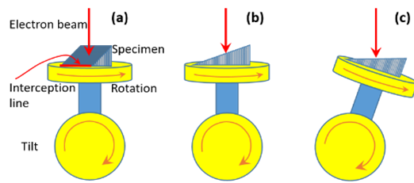
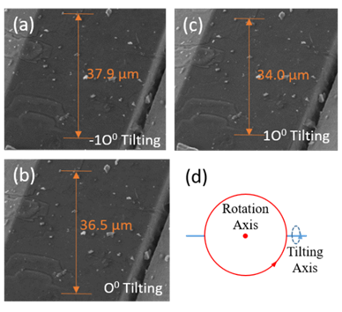
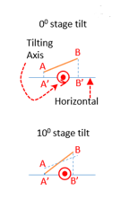
Predetermined Methodology
Figure 1:
Requirements for proper EDS analysis
Can easily be done on the macroscale
For simplicity, we use 10cm – 45-degree ramp in the experiment
Perform on-site specimen orientation, must be done from top-down view
Figure 2 represents how projected lengths change based on perpendicular tilt
Figure 2:

Slide 7
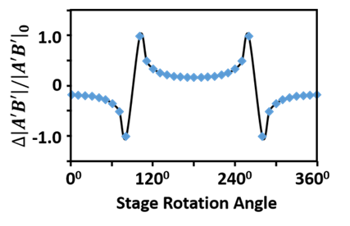
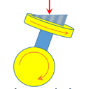
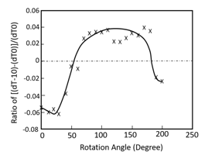
Predetermined Methodology
First image shows theoretical results and gives us our “special rotation angle”
Second image shows experimental results from inside a SEM
The goal is to produce results like these on the macroscale where the measurements can be done by hand

Slide 8
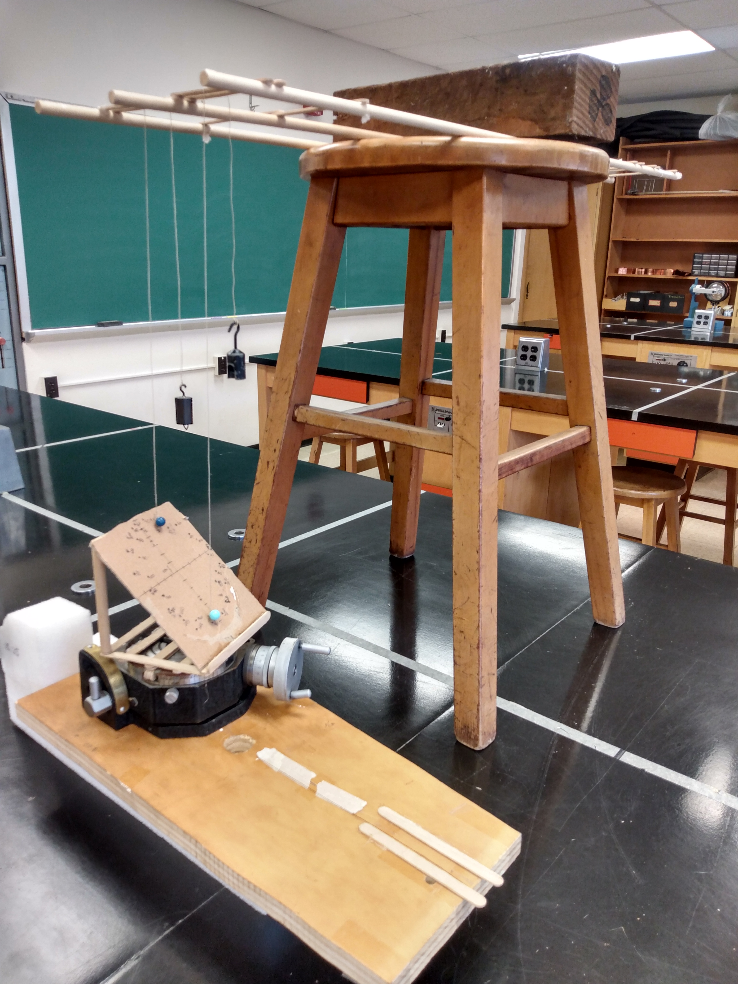
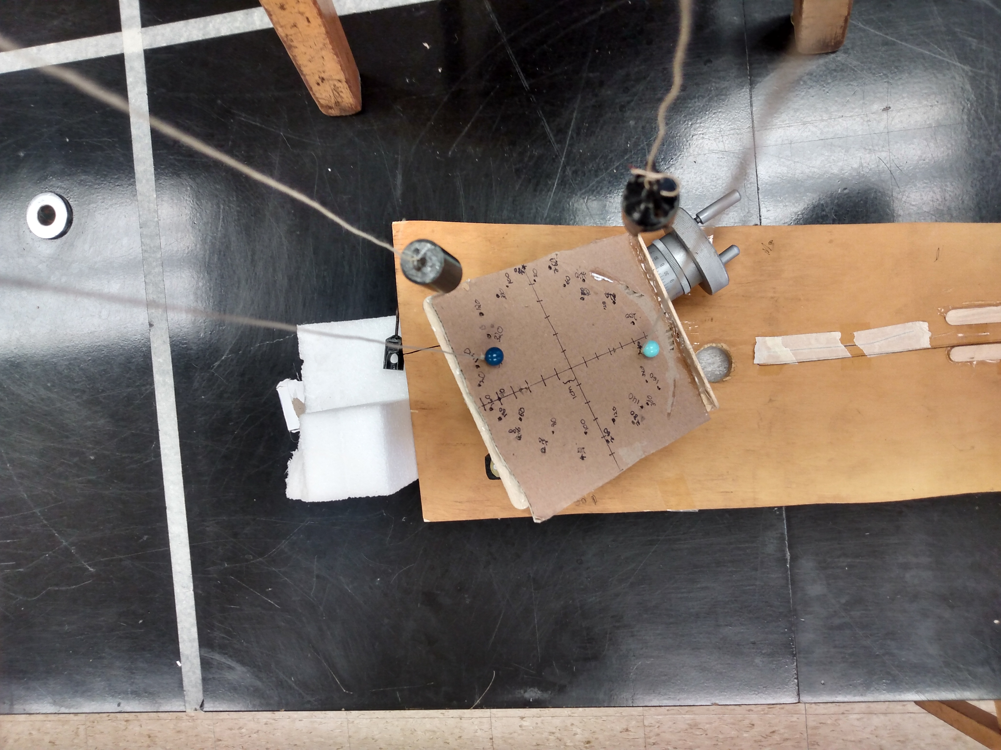
The Experiment

Slide 9
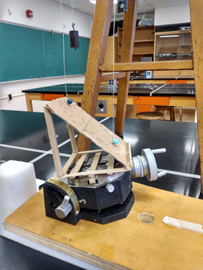
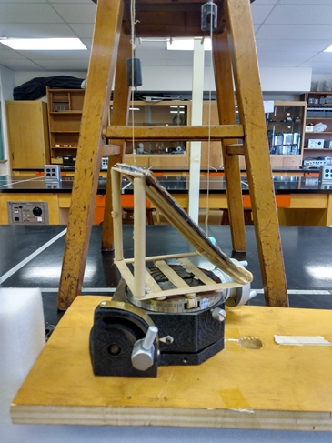

Slide 10
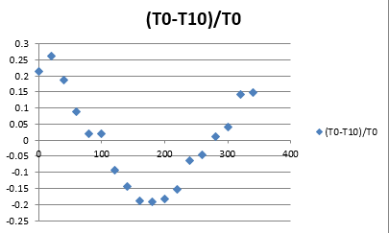
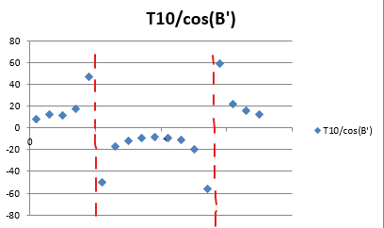
The Results
Top graph shows experimental results similar to those found in the initial experiment by PI
Bottom graph shows results based on actual measurements, but applied in a way that resembles the theoretical results
Both graphs represent the same idea, the “special rotation angle” is when our wedge is parallel to the tilting axis, either at 0 degree or 180 degree rotation

Slide 11
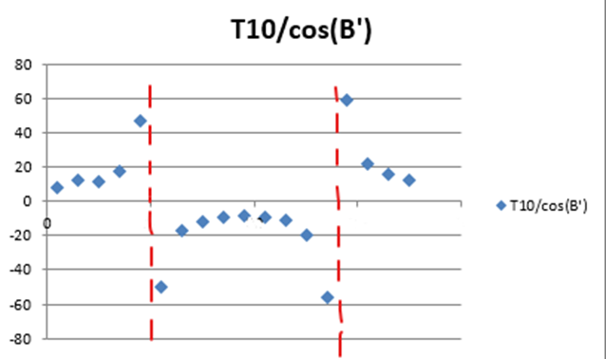
Conclusions and Recommendations
The methodology developed by PI and CU gives consistent and comprehensible results
The main issue lies in our areas of uncertainty, where our measurements aren’t quite clear
To gain clearer results in these areas, I recommend further experimentation with a larger apparatus
The next step would be to take measurements in a digital format
This would closer resemble the actual process conducted within the SEM

